Slide 1

Prototype of a Blockchain-Based Sugar Beet Production Tokenization System
Master Thesis
Mentor: Dr. Dušan Gajić, Associate Professor
Candidate: Mihajlo Bogdanović RA 64/2021
University of Novi Sad • Faculty of Technical Sciences

Slide 2

Problem and Motivation
Traditional Funding Models
Complex and slow processes
Limited access for small investors
High administrative costs
Lack of transparency
Consequences
Farmers face difficult access to capital, while small investors lack access to profitable projects.

Slide 3


Goal of the Thesis
DApp Prototype Development
Investment Simulation
The administrator records the payment and issues ERC-20 tokens.
Decentralized application for tokenizing investments in sugar beet production.
Claiming Yield
Users claim yield upon the expiration of the investment cycle.

Slide 4
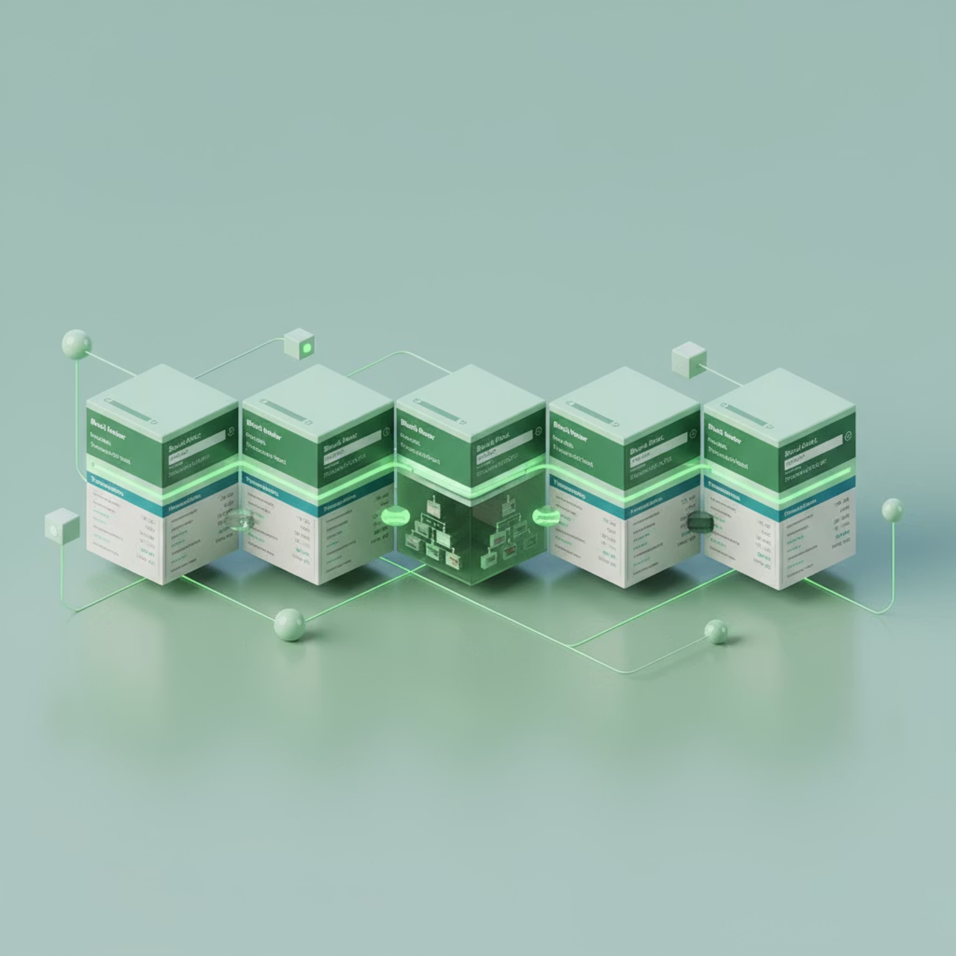
Blockchain Technology
Key Characteristics
Decentralization
Data is distributed among participants, eliminating a single point of failure.
Immutability
Transactions cannot be altered or deleted.
Transparency
All transactions are publicly visible for easy verification.

Slide 5
Smart Contracts and ERC-20 Standard
Smart Contracts
ERC-20 Standard
BEET token
Self-executing digital agreements on the blockchain. They are automatically executed when pre-defined conditions are met, without the need for an intermediary.
A technical standard for creating fungible tokens on the Ethereum blockchain. It defines functions for compatibility and interoperability (e.g., balanceOf, transfer).
Our token, based on the ERC-20 standard, is a digital proof of investment in sugar beet production.

Slide 6
Tokenization of Real-World Assets
The process by which rights to real-world assets are converted into digital tokens on the blockchain.
Increased Liquidity
Fractional Ownership
Transparency
Traditionally illiquid assets are divided into smaller fractions for easier trading in investment markets.
Dividing ownership into smaller parts enables faster investment for small investors.
Ownership and transactions are publicly and securely recorded, allowing for verifiable confirmation.

Slide 7
Technologies Used
React
Node.js / Express
JavaScript library for dynamic and interactive user interfaces.
JavaScript backend environment, managing users and authentication.
PostgreSQL
Solidity
Relational database for storing user data and roles.
Programming language for smart contracts on the Ethereum blockchain.
Ethers.js
MetaMask
JavaScript library for communicating with the Ethereum blockchain.
Digital wallet for interacting with decentralized applications.

Slide 8

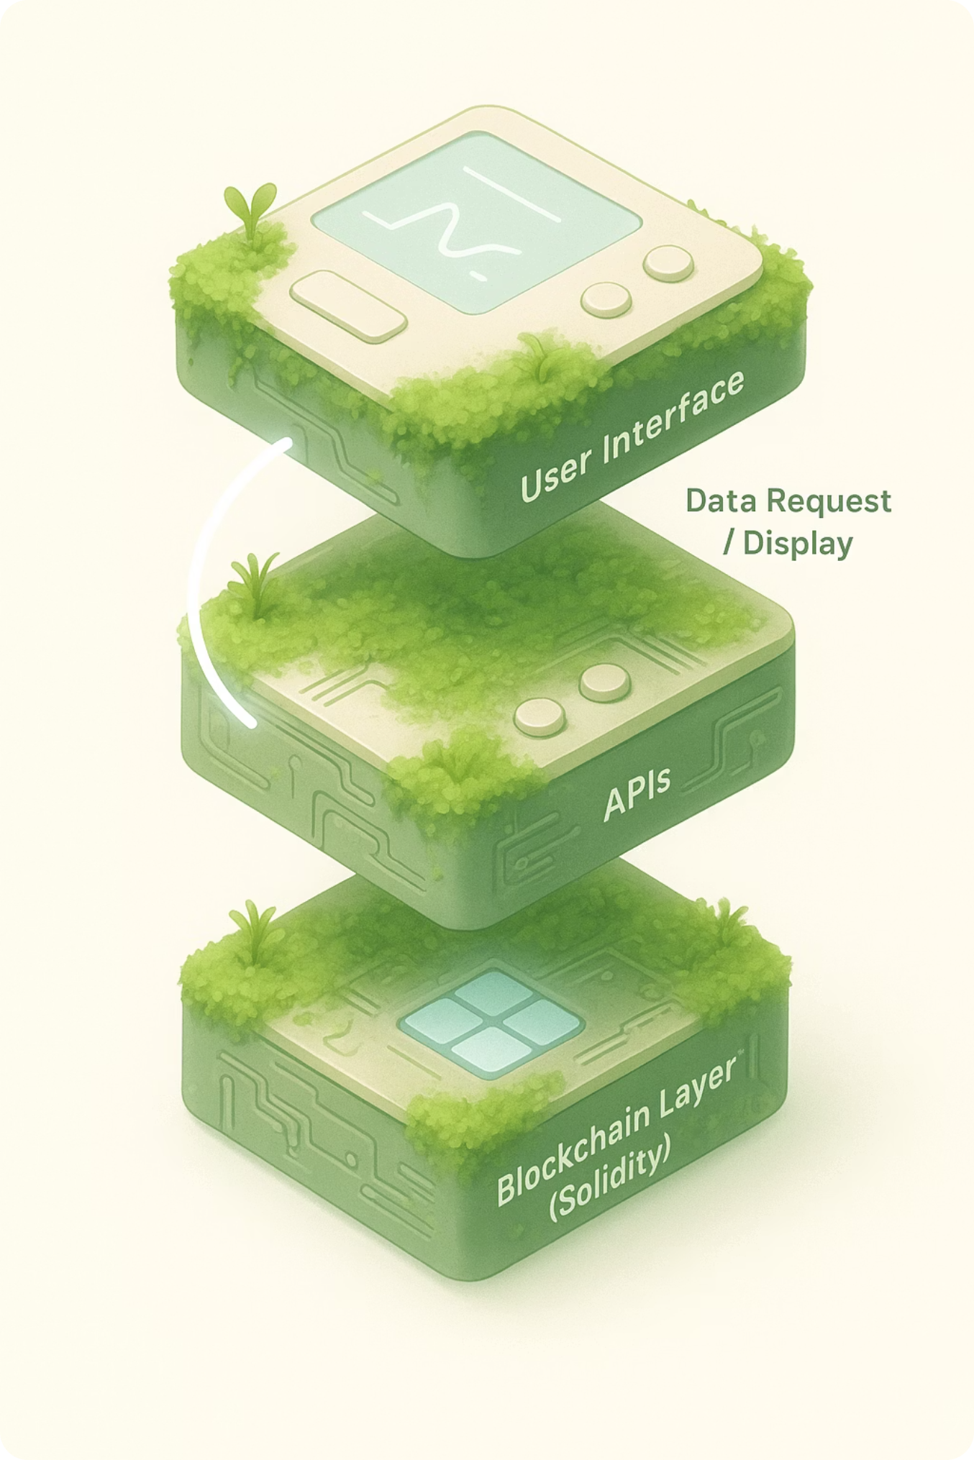


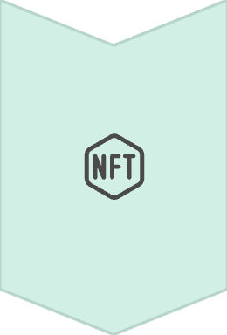
System Architecture
Frontend (React)
User interface for registration, login, investment overview, and connection with MetaMask wallet.
Backend (Node.js)
Business logic, user management, JWT authentication, and administrative transactions.
Blockchain (Solidity)
Smart contracts on the Sepolia test network for secure data storage and rule execution.

Slide 9

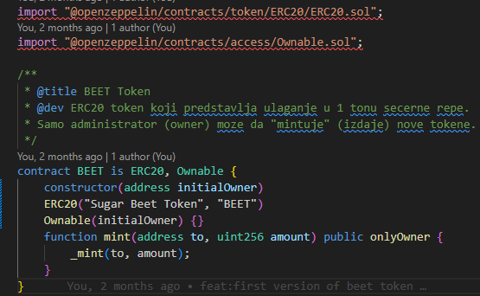
Smart Contract Design
BEET.sol
Treasury.sol
ERC-20 contract for BEET token. Inherits Ownable, restricting the mint function to the owner.
Central contract with business logic.
recordInvestment - Records payment and mints tokens
Implements ERC-20 standard
claimYield - Request for yield after maturity
Controlled token issuance
Ownership transferred to Treasury
Storage of Investment structures
Rule verification through require statements

Slide 10
Backend Architecture
Routes
Define API routes and connect them to controllers.
Controllers
Receive HTTP requests, validate, and call service functions.
Services
Main business logic (password hashing, JWT tokens).
Repositories
Direct communication with the PostgreSQL database and blockchain.
Middleware
Functions for route protection and JWT token verification.

Slide 11

Registration and Authentication
1
Registration
The user enters data. The backend hashes the password (bcryptjs) before writing it to the database.
2
Login
The system checks credentials (bcrypt.compare) and generates a JWT token.
3
Session
The JWT token is stored in localStorage and added to the Authorization header.
4
MetaMask
The user connects the wallet; the system checks for address matching with the database.

Slide 12
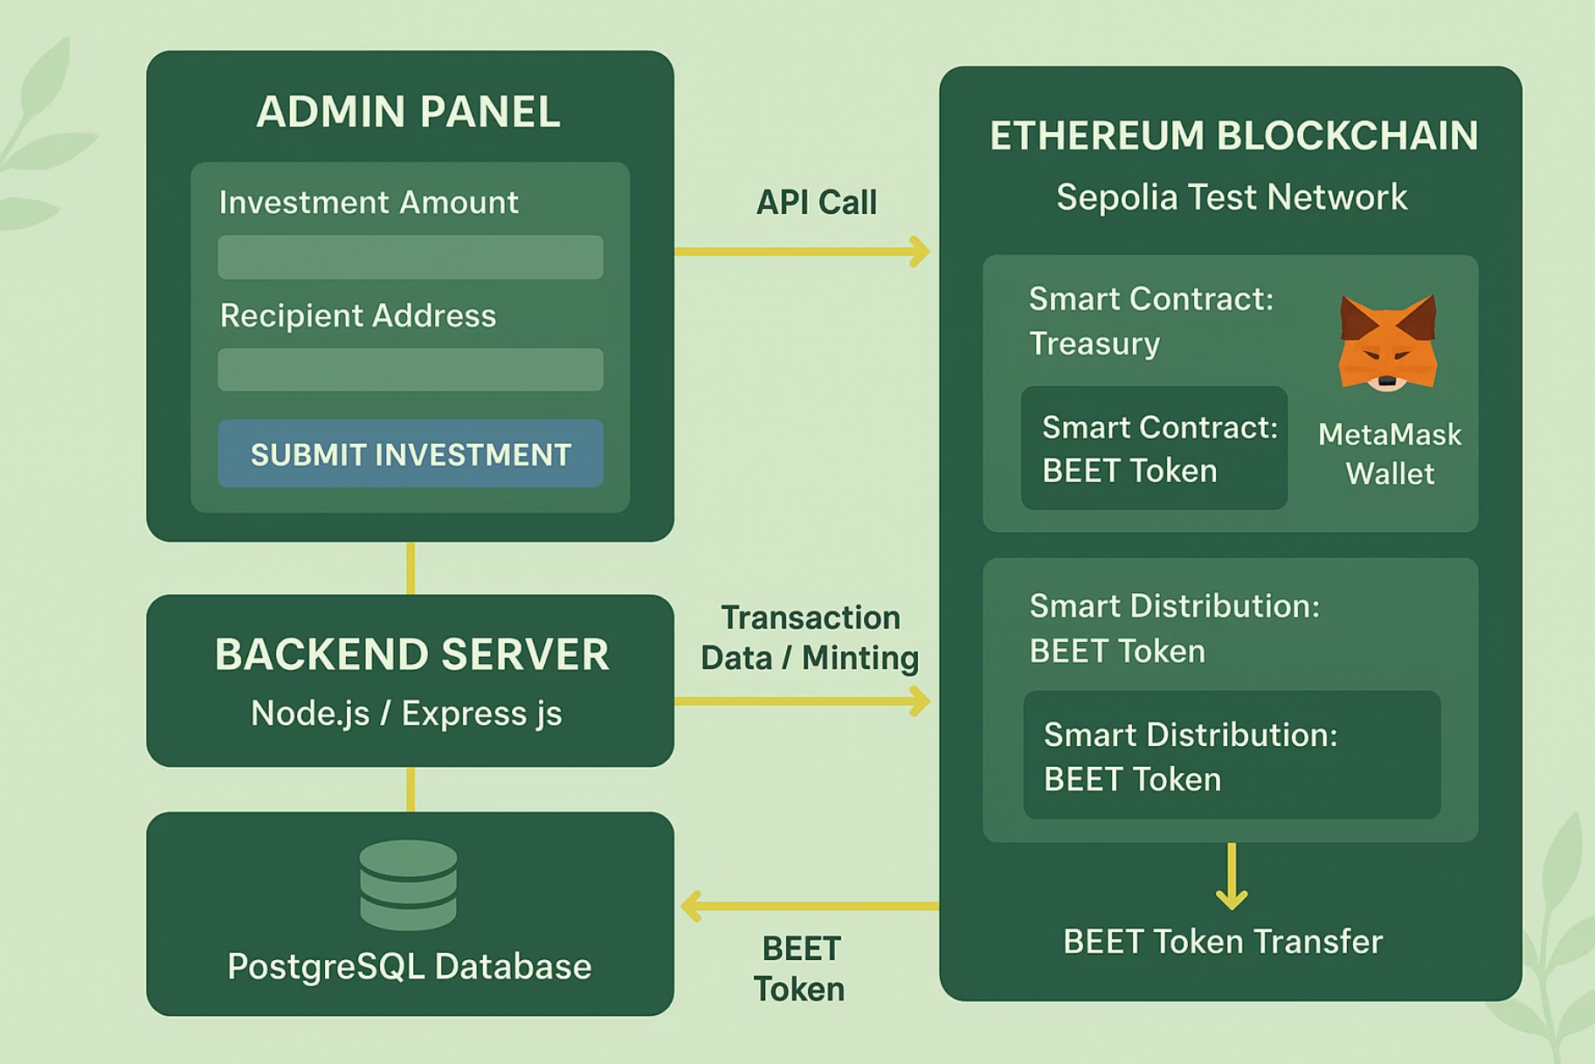
Administrator Panel - Investment Recording
Process
The administrator enters the ETH address and the number of BEET tokens.
The frontend calculates the amount in USD and sends the data.
The backend creates and signs the transaction (ethers.js).
The transaction is sent to the Sepolia test network.
The Treasury smart contract records the investment and initiates the mint function.
Result: The backend returns txHash as confirmation of successful blockchain recording.
Tokens are transferred to the investor's address.

Slide 13
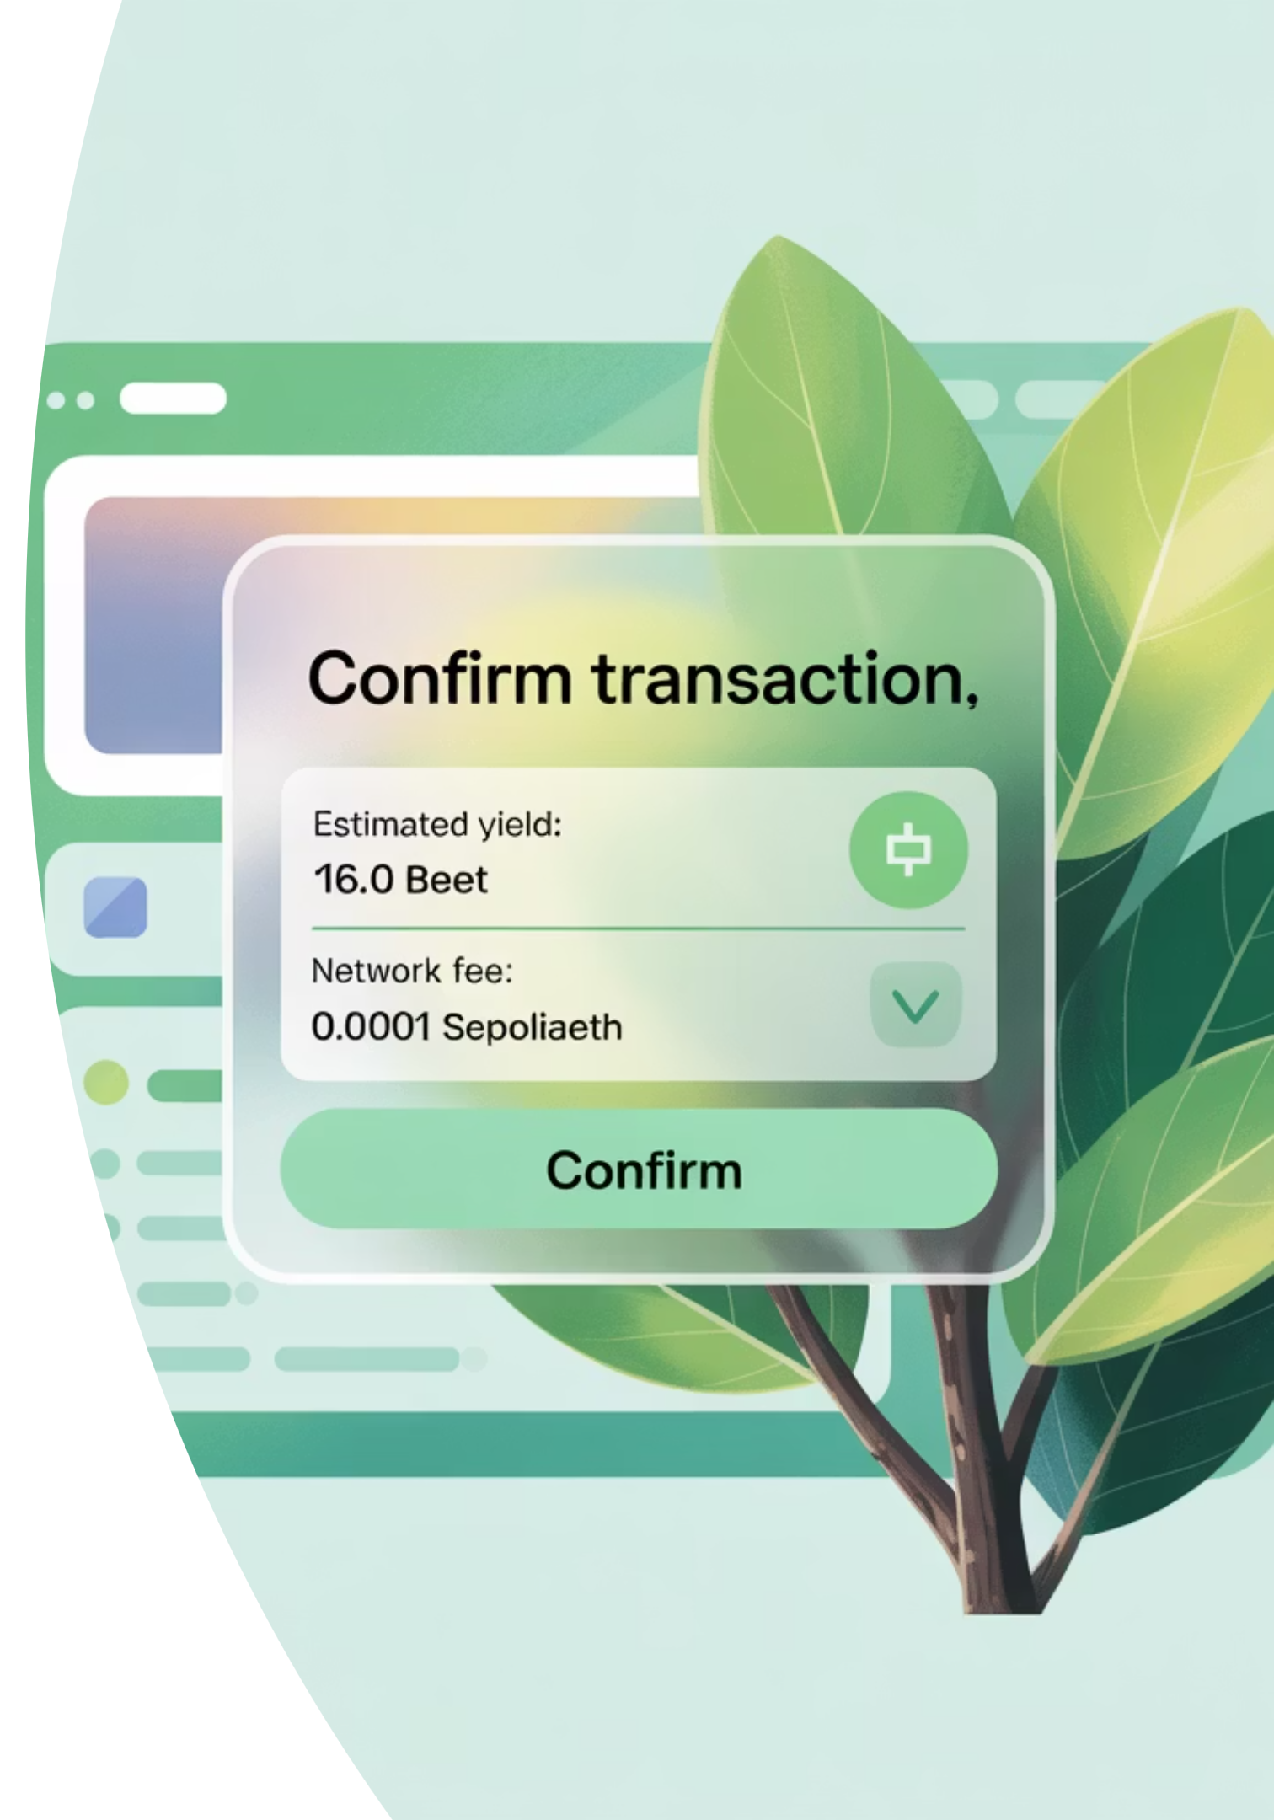
Claim Yield
Maturity Check
1
Frontend checks maturesOn and time.
Transaction Initiation
2
User clicks 'Claim Yield' to trigger handleClaim (ethers.js).
MetaMask Confirmation
3
MetaMask window: transaction review and manual confirmation.
Execution
4
The contract verifies conditions, changes status to isClaimed = true, completing the investment cycle.

Slide 14

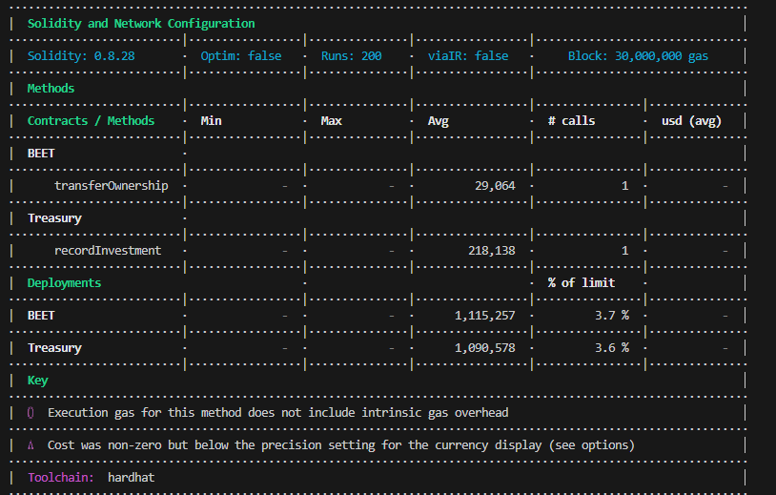
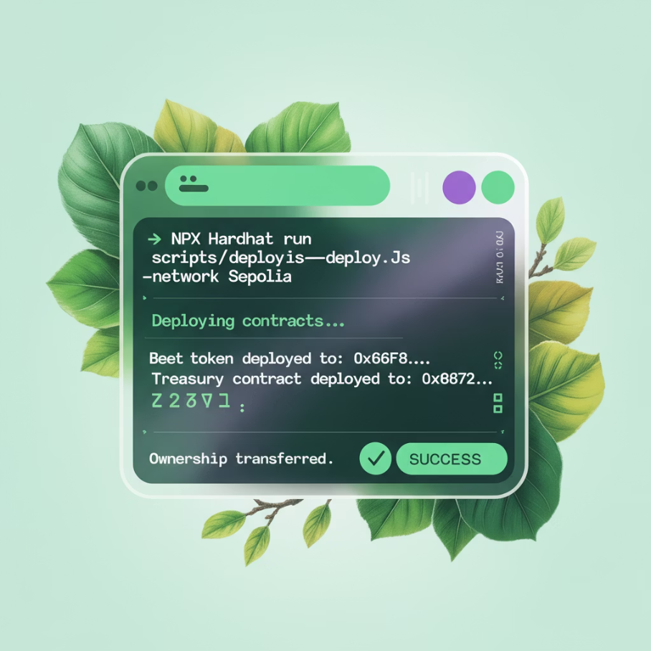
Testing and Deployment
Automated Testing
Deployment on Sepolia
Tested with Mocha and Chai (Hardhat):
Deployed to the Ethereum Sepolia test network:
recordInvestment restriction (admin only)
Hardhat configuration
Accurate token minting
Infura RPC URL
Proper ownership transfer
Paying gas fees (test ETH)
Etherscan verification

Slide 15
Conclusion and Future Directions
Achieved Results
Successfully developed a full-stack prototype. Demonstrated practical application of real-world asset tokenization and simulation of the entire investment lifecycle.
Key Advantages
High transparency (public transactions), increased investment accessibility for small investors, and automated rule execution via smart contracts.
Future Development
Integration with payment systems
More advanced admin panel (analytics)
Migration to main Ethereum network or Layer 2
Implementation of KYC procedures
Backend performance improvement

